Slide 1
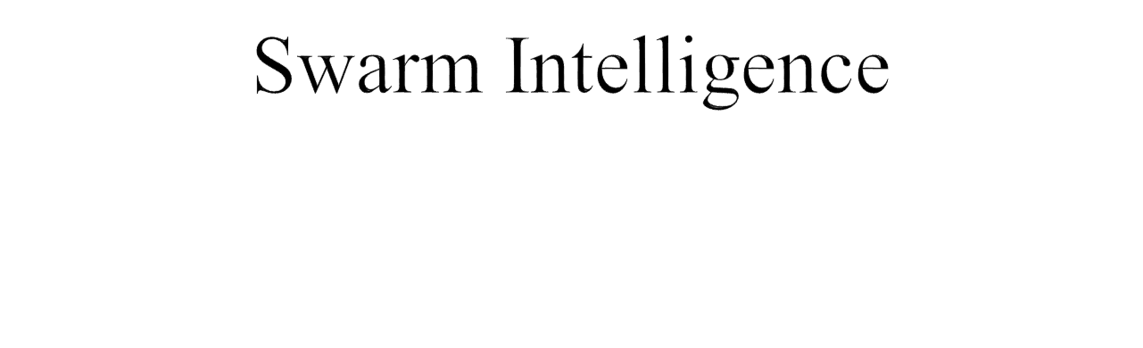
Lecture Module 24

Slide 2

Swarm describes a behaviour of an aggregate of animals of similar size and body orientation.
Swarm intelligence is based on the collective behavior of a group of animals.
Collective intelligence emerges via grouping and communication, resulting in successful foraging (the act of searching for food and provisions) for individual in the group.
Examples of swarms
  Bees, ants, termites, fishes, birds etc
  Marching of ants in an army
  Birds flocking in high skies
  Fish school in deep waters
  Foraging activity of micro-organisms

Slide 3

In the context of AI, SI is based on the collective behavior of decentralized, self-organized systems.
SI systems are typically made up of a population of simple agents interacting with one another locally and with their environment causing coherent functional global pattern to emerge.
Using SI, it is possible to explore collective or distributed problem solving without centralized control or the provision of a global model.
Even with no centralized control structure dictating how individual agents should behave, local interactions between agents lead to the emergence of complex global behavior.
Swarms are powerful which can achieve things which no single individual could do.

Slide 4
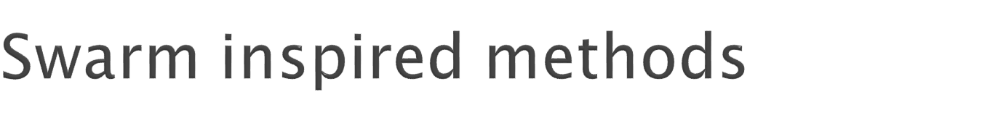
ANT COLONY OPTIMIZATION (ACO)‏
  Invented by Marco Dorigo in 1991
  Inspired by behaviour of ants.
  Real ants lay down pheromones directing each other to resources while exploring their environment.
  Used extensively for discrete optimization problems
PARTICLE SWARM OPTIMIZATION (PSO)‏
  Population based stochastic optimization technique developed by Eberhart and Kennedy in 1995
  Inspired by social behaviour of flocks of birds and school of fish

Slide 5
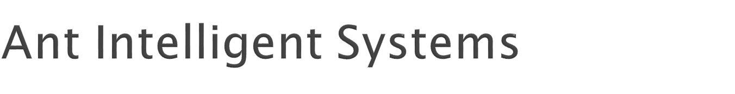
A set of agents (similar to ants), search in parallel for good solutions and co-operate through the pheromone-mediated indirect method of communication.
They belong to a class of meta-heuristics.
These systems started with their use in the Traveling Salesman Problem (TSP).
They have a gamut of applications to practical problems faced in business and industrial environments.

Slide 6
The evolution of computational paradigm for an ant colony intelligent system (ACIS) is being used as an intelligent tool
  to help researchers solve many problems in areas of science and technology.
Attractive features
  Positive feedback
  Negative feedback
  Multiple interaction
  Distributed computation
  Constructive greedy heuristic approach

Slide 7
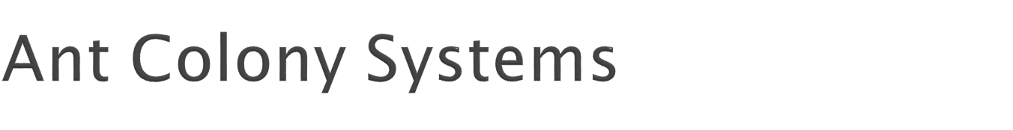
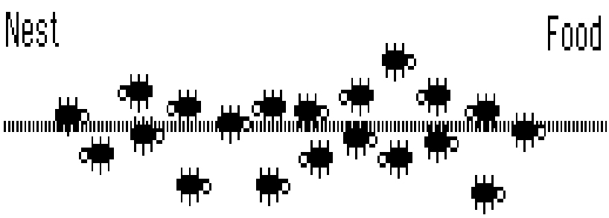
Biological Ant Colony Systems
  Organizing highways to and from their foraging sites by leaving pheromone trails
  Form chains from their own bodies to create a bridge to pull and hold food together
  Division of labour between major and minor ants

Slide 8

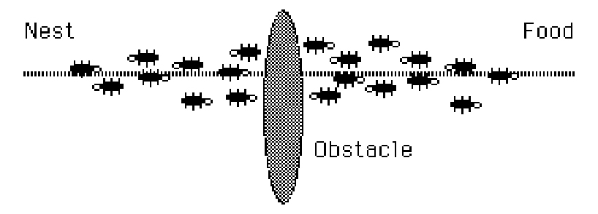

Slide 9

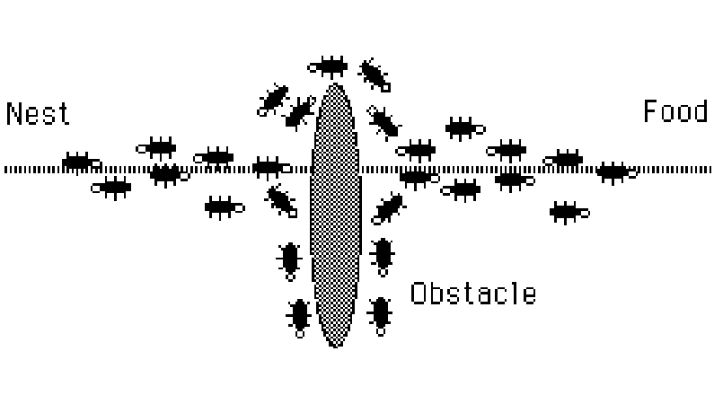

Slide 10

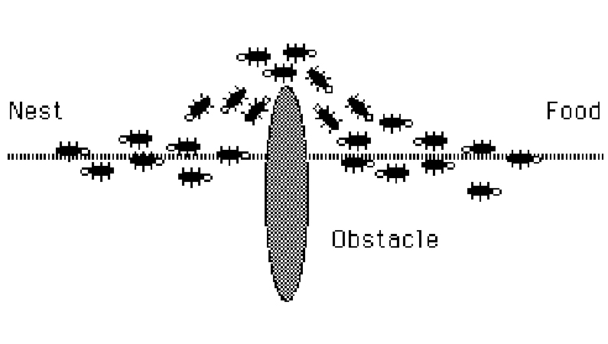

Slide 11
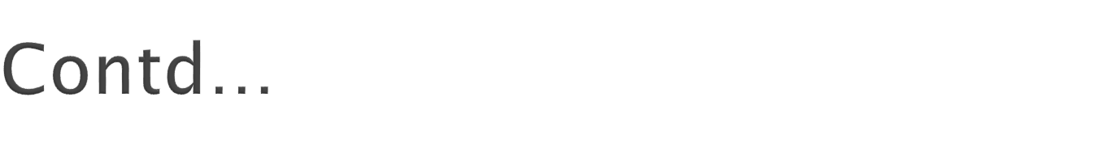
How do real ants find the shortest path
  Ants can smell pheromones, they tend to choose the paths marked by strong pheromone concentrations.
  The emergence of shortest paths can be explained by
    Autocatalysis : positive feedback
    Differential path length
  Communication is indirect through pheromones.
  Ants indirectly influence other ants to follow the path (Recruitment)‏

Slide 12
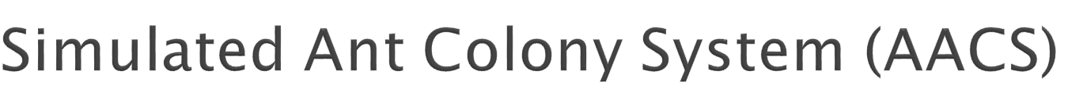
Similarities
  A colony of cooperating individuals
  An artificial pheromone trail for communication
  A sequence of local moves for finding the shortest paths
  A stochastic decision policy using local information and no look ahead
Differences‏
  Ant moves are discrete,
  Ants have an internal state having memory of past actions
  Ants can deposit a particular amount of pheromone at certain time instances which may not reflect real behaviour
  Enrichment with other techniques like backtracking, etc

Slide 13
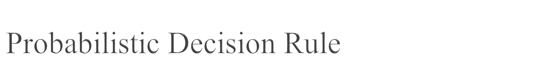
Working involves two procedures
  Specifying how ants construct or modify a solution for the problem in hand.
    Done in a probabilistic way based on problem dependent heuristics and amount of pheromone previously deposited in this trail.
  Updating the pheromone trail.
Let k^{th} ant (denoted by ant_{k}) is located at the i^{th} node and pt_{ij} is intensity of pheromone trail on the arc(i, j).

Slide 14
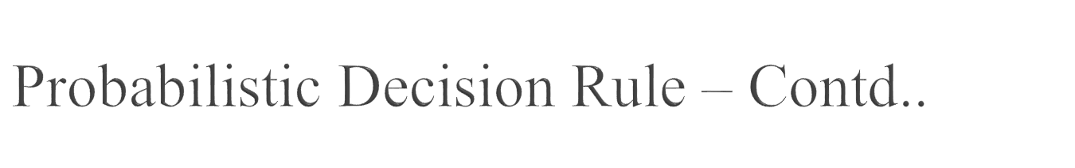
The probability of moving ant_{k} located in i^{th} node to j^{th} node is defined as follows:
prob_{ij}(k) = pt_{ij} / ∑ pt_{im} , ∀ m ∈ Neighour set of i
We can also define probability of ant_{k} moving from i^{th} node to j^{th} node as follows:
prob_{ij}(k) = (pt_{ij} )^{α} (η_{ij})^{β} / ∑ (pt_{im} )^{α} (η_{im})^{β} ,
∀ m ∈ Neighour set of i
  where η_{ij} is the value of visibility of arc(i, j), α and β are control parameters.

Slide 15
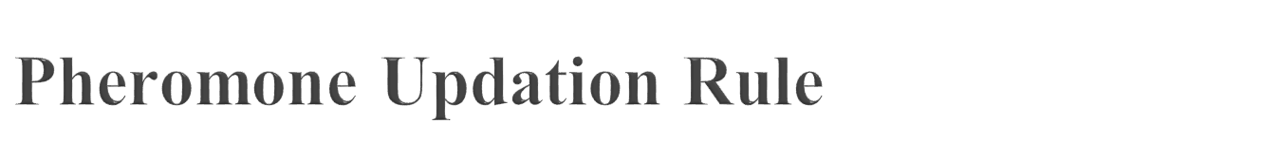
In simple ACO algorithm, constant amount of pheromone Δ is deposited by ants.
The pheromone updation at time ‘t’ from i^{th} node to j^{th} node is defined as follows
  pt_{ij} (t) = pt_{ij}(t) + Δ
This increases the probability of the arc that can be used by other ants in future.

Slide 16
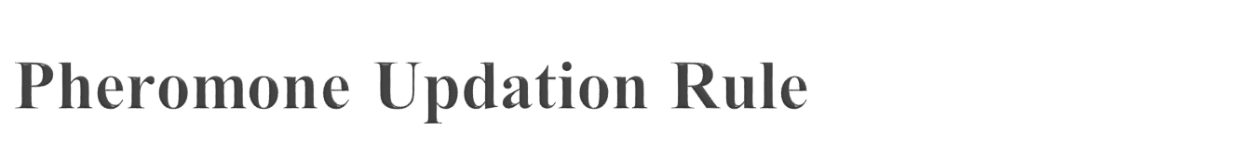
Alternatively at the end of each cycle (or route), the intensity of pheromone trails on each arc is updated by the following pheromone updating rule
pt_{ij} =ρ pt_{ij} + ∑Δpt_{ij}(k), k = 1 to m
  where ρ ∈ (0,1) is the persistence rate of previous trails, Δpt_{ij}(k) is the amount of pheromone laid on arc(i, j) by the ant_{k} at the current cycle, and m is the number of distributed ants.

Slide 17
To avoid quick convergence of all the ants towards sub optimal path, an exploration mechanism is added.
It is similar to pheromone trail evaporation in real scenario.
It is carried out by decreasing pheromone trail in each iteration of algorithm using the following factor.
  Δ = (1 - γ )*Δ , γ ∈ (0, 1)
This decrease can be done in various ways, such as:
  While moving from i^{th} node to j^{th} node, ant can update pheromone trail pt_{ij} on the arc(i, j).
  Once the solution is built, the ant can retrace the same path and update pheromone trail of the each arc on the path.
  Pheromone trail can be updated offline using global information.

Slide 18
Traveling Salesman Problem
Quadratic assignment
Job shop scheduling
Vehicle routing
Sequential ordering
Graph colouring
Network routing
Flow manufacturing
Layout of facilities
Space planning
Numeric optimization

Slide 19

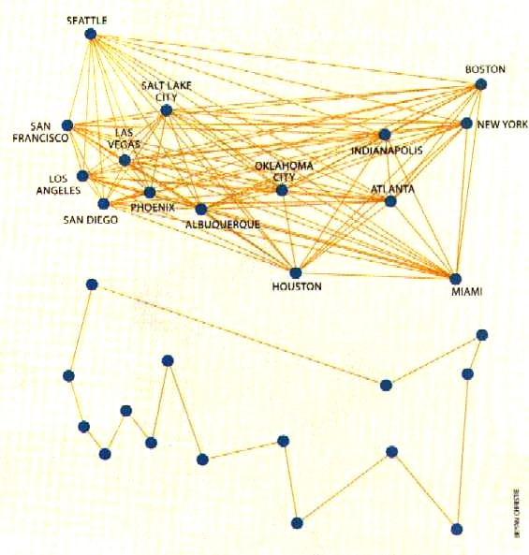
Traveling Salesman Problem
  Hard combinatorial problem
  Because of suitability and flexibility, ant intelligence is used

Slide 20
At time t = 0, distribute m ants uniformly or randomly, position them in different cities and set their initial value to a small positive constant. Set the first element of each ant's tabu list to its starting city.
At some time t+1, move each ant from city i to j according to the probabilistic transition rule in accordance with the tabu list maintained for that particular tour. Continue this for n iterations to complete an entire tour or cycle.
Save the minimum distance covered among all the tour distances covered by ants for that particular tour or when one cycle is completed.

Slide 21
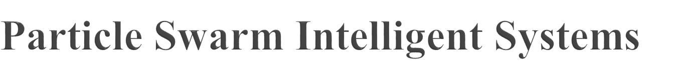
Originated with the idea to simulate the unpredictable choreography of a bird flock with
  Nearest-neighbour velocity matching
  Multi-dimensional search
  Acceleration by distance
Advantages
  Simple
  Few parameters
  Easy to implement
  Robust
  Searches a much larger portion of the problem space

Slide 22
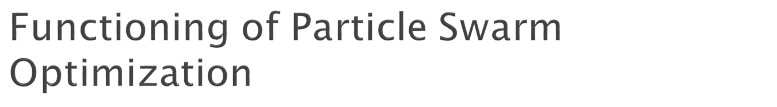
Swarm is defined as a group of individuals/particles flying in a multidimensional space in such a manner that each possesses a position and velocity at any instant of time.
Each particle also possesses memory of its best position and the knowledge of the best position of its neighbours and also that of the global best position.
Each particle communicates with its neighbours and gathers information about good positions and then alters its position and velocity in order to achieve this good position.

Slide 23

A particle has the following information to make a suitable change in its position and velocity:
  A global best position that is known to all particles.
  This global best is immediately updated as soon as a new best position is located by any particle in the swarm.
  Neighbourhood best that the particle obtains by communicating with a subset of the swarm.
  The local best, which is the best solution that the particle has seen.

Slide 24
PSO shares many similarities with Genetic Algorithms (GA).
The system is initialized with a population of random solutions (called particles) and searches for optima by updating generations.
Each particle is assigned a randomized velocity.
However, unlike GA, PSO has no evolution operators such as crossover and mutation.
Compared to GA, the advantages of PSO are that PSO is easy to implement and there are few parameters to adjust.

Slide 25
Each particle adjusts its position according to
  its own experience and
  the experience of a neighboring particle
Particle keeps track of its co-ordinates in the problem space which are associated with its best solution/fitness achieved so far denoted by pbest.
Overall best value obtained so far is also tracked by the global version of the particle optimizer along with its location (gbest).
Two versions (according to acceleration)‏
  Global
    At each time step, the particle changes its velocity (accelerates) and moves towards its pbest and gbest.
  Local
    In addition to pbest, each particle also keeps track of the best solution (lbest/nbest – neighbour best) attained within a local topological neighbourhood of the particle.
    The acceleration thus depends on pbest, lbest, and gbest.

Slide 26
The particle position and velocity update equations in the simplest form that govern the PSO are given by
Following figure shows the position and velocity of i-th particle at time t.
X_{i}(t) V_{i}(t)
V_{i}(t+1)
Where
  α - inertia weight that controls the exploration and exploitation of the search space
  C2, C2 and C3 - the acceleration constants which changes the velocity of a particle towards the pbest (particle best) nbest (neigbours best) and gbest (global best).
  R1, R2 and R3 are random numbers between 0 and 1.
  operator ° indicates vector multiplication

Slide 27

Position Updation: For performing the position update it uses following formula
X_{i} (t + 1) = X_{i} (t) + V_{i} (t + 1)
This process is repeated for every particle used in the computation and the best optimal solution is obtained.

Slide 28

The basic operation of PSO are given as follows:
Initialize the swarm from the solution space
Evaluate fitness of individual particles
Modify Pbest, Nbest, Gbest and velocity
Move each particle to a new position
Goto step 2, and repeat until convergence or stopping condition is satisfied

Slide 29
PSO has been successfully applied in many areas: function optimization, artificial neural network training, fuzzy system control, and other areas where GA can be applied.
Important applications
  Ingredient mix optimization
  Reactive power and voltage control
  Evolving neural networks
  Optimization problems
  Classification
  Pattern recognition
  Biological system modeling
  Scheduling
  Signal processing
  Robotic applications
  Decision making

Slide 30

Consider a normal solution sequence of TSP with n nodes
S = (a_{i}), i=l ... n.
The Swap Operator SO(i₁, i₂) is defined as exchanging the node at i₁ and i₂ position in solution S.
Then the new solution S' is defined as
S'=S+ SO(i₁, i₂),
The plus sign " + ' above has its new meaning.
For example: Suppose there is a TSP problem with five nodes.
Let S=(l, 3, 5, 2, 4) is a particle/solution.
The Swap Operator SO(1,2) is applied on S as follows:
S'= S + SO(1, 2)= (1, 3, 5, 2, 4) + (1, 2) = (3, 1, 5, 2, 4).

Slide 31
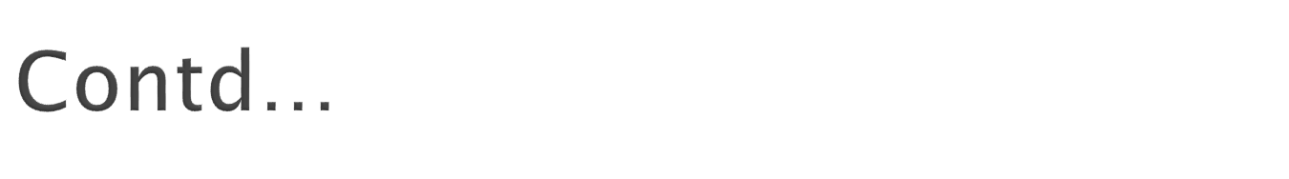
A Swap Sequence SS is made up of one or more Swap Operators.
  SS=(SO1, SO2, SO3, ..., SOn)
  SO1, SO2, SO3, ..., SOn are Swap Operators, and the order of the Swap Operators in SS is important.
Swap Sequence acting on a solution implies all the Swap Operators of the Swap Sequence act on the solution in order.
This can be described by the following formula:
S'= S + SS = S + (SO1, SO2, SO3, ..., SOn) = ((S+ SO1)+ SO2)+ ... + SOn

Slide 32

Adaptability
  Self-organizing
Robustness
  Ability to find a new solution if the current solution becomes invalid
Reliable
  Agents can be added or removed without disturbing behaviour of the total system because of the distributed nature
Simplicity
No central control

